Slide 1


Future of SE Research:
Research for SE,
SE for Research
tim.menzies@gmail.com
https://menzies.us
October 2015
Slides: tiny.cc/gale15
ai4se.net

Slide 2
Software tools for “citizen scientists”.
Beyond mere data repositories
Software decides how we decide everything
When decision software goes wrong
Proposed services for nextgen repositories
The Future?
ai4se.net

Slide 3
Software tools for “citizen scientists”.
Beyond mere data repositories
Software decides how we decide everything
When decision software goes wrong
Proposed services for nextgen repositories
The Future?
ai4se.net

Slide 4

Data mining tools should, and can, do much more
Operating systems do more than just schedule processes.
They offer many other services
File systems,
network connections,
memory management
journaling
Etc
Data mining tools should offer more than just predictors.
A whole host of facilities for sharing, privacy, compression, planning, anomaly detection, etc Turns out, simple data structures can support all the above
This talk: WHERE (but no doubt there are other data structures as well)
ai4se.net

Slide 5
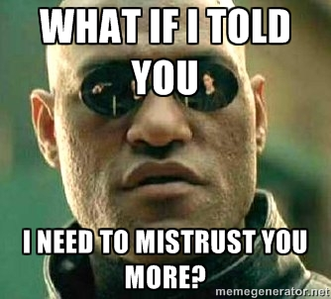
Today’s topic: Software tools for “citizen scientists”
Science has escaped the lab and is roaming free in the world.
People use software to understand the world
What tools are needed to support that work?
Want to mistrust the conclusions of the citizen scientists
Just as we mistrust and evaluate, review, explore, evolve the conclusions of any other scientist.

Slide 6
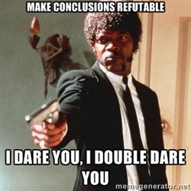
When every citizen can be a scientist (making generalizations from data)
It should be possible to for everyone else to
audit a conclusion;
to repeat (at least in part) the processes that lead to that conclusion;
to reconsider parts of old conclusions;
to decide what a conclusion from some other site does/does not apply locally.

Slide 7
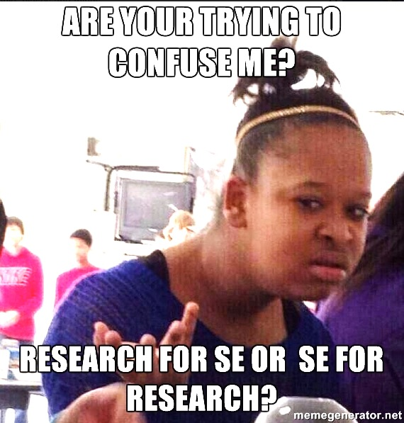
Yes.
ai4se.net

Slide 8
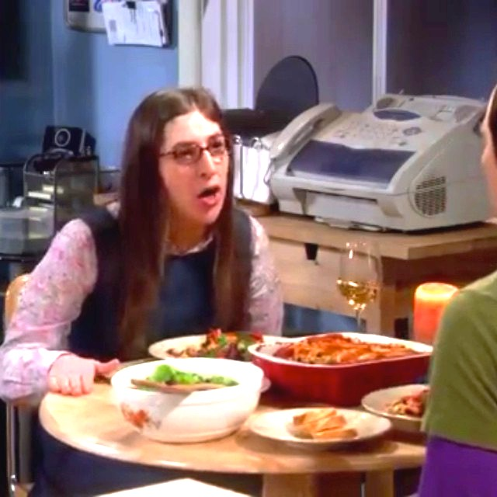
Recall the words of Dr. Amy Farrar Fowler, Ph.D.
Amy: My colleagues and I are mapping the neurological substrates that subserve global information processing, which is required for all cognitive reasoning, including scientific inquiry, making my research ipso facto prior in the ordo cognoscendi.
Sheldon: Excuse me, but a grand unified theory, insofar as it explains everything, will ipso facto explain neurobiology.
Amy: Yes, but if I’m successful….
I will be able to map and reproduce your thought processes in deriving a grand unified theory, and therefore, subsume your conclusions under my paradigm.
Apologies to fans of the BBT:
This conversation occurred in JPL,
cafeteria, not Amy’s flat
ai4se.net

Slide 9
What’s not in this talk
Qualitative methods for analytics
Principles for designing case studies
Visualizations
Data mining

Slide 10
What’s is in this talk
O(n) methods

Slide 11
Software tools for “citizen scientists”.
Beyond mere data repositories
Software decides how we decide everything
When decision software goes wrong
Proposed services for nextgen repositories
The Future?
ai4se.net

Slide 12
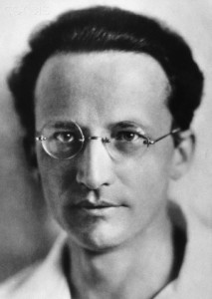
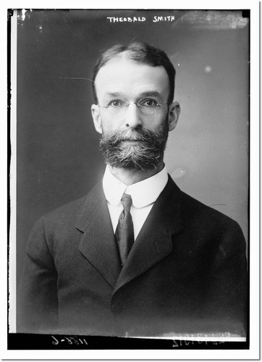
The PROMISE Project
If you cannot- in the long run- tell everyone what you have been doing, your doing has been worthless.
Erwin Schrodinger Nobel Prize winner in physics 1887 -- 1961
Research has deserted the individual and entered the group. The individual worker find the problem too large, not too difficult. (They) must learn to work with others.
Theobald Smith American pathologist and microbiologist 1859 -- 1934

Slide 13
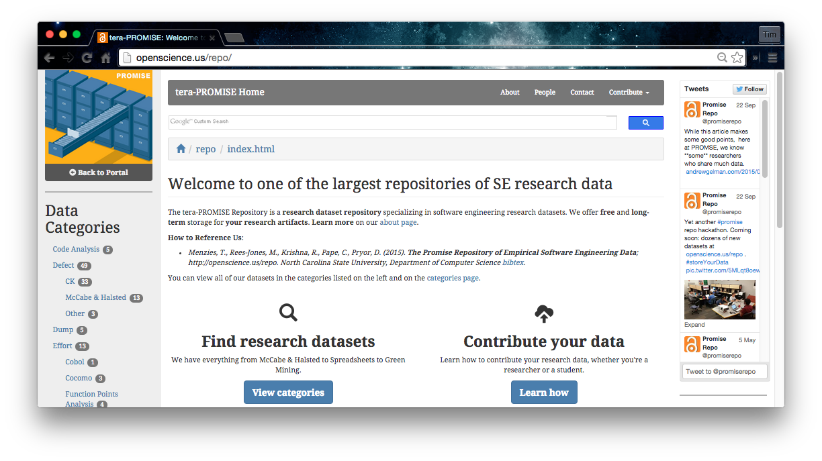
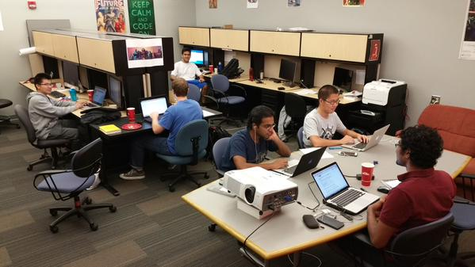

http://openscience.us/repo
#storeYourData
URL openscience.us/repo
Data from 100s of projects
E.g. EUSE: 250,000K+ spreadsheets
E.g. Softgoals: 150+ softgoal models
Oldest continuous repository of SE data (2004)

Slide 14
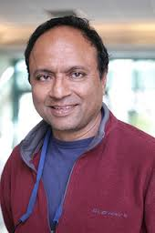
If it works, try to make it better
The PROMISE Project
“The following is my valiant attempt to capture the difference (between PROMISE and MSR)”
“To misquote George Box, I hope my model is more useful than it is wrong:
For the most part, the MSR community was mostly concerned with the initial collection of data sets from software projects.
Meanwhile, the PROMISE community emphasized the analysis of the data after it was collected.”
“The PROMISE people routinely posted all their data on a public repository
their new papers would re-analyze old data, in an attempt to improve that analysis.
In fact, I used to joke “PROMISE. Australian for repeatability” (apologies to the Fosters Brewing company). “
Dr. Prem Devanbu
UC Davis
General chair, MSR’14

Slide 15
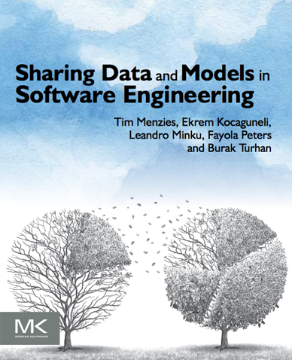
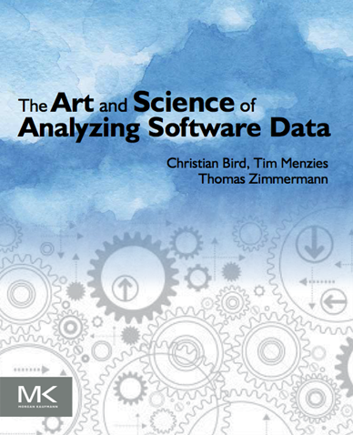

The PROMISE Project
Our summary. And other related books
The MSR
community
and others
Perspective on Data Science for Software Engineering
Tim Menzies
Laurie Williams
Thomas Zimmermann
2014
2015
2016

Slide 16
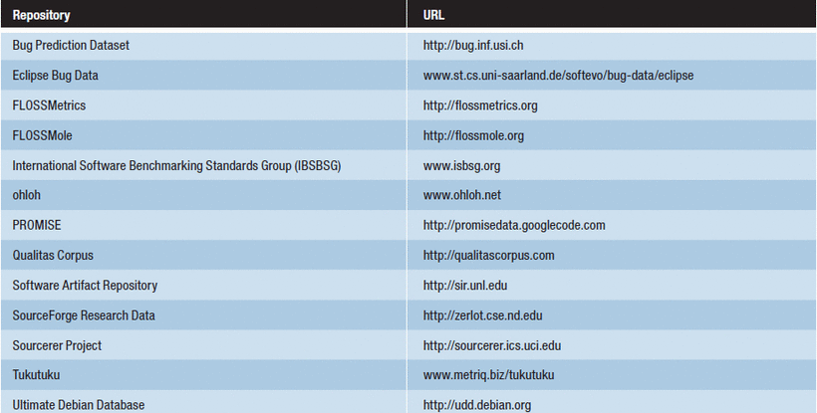
So many data repositories
What’s next?
What tools would we need for an “debate”-oriented repository ?

Slide 17
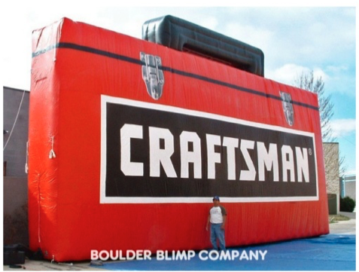
Let’s talk tools
To design those tools, ask:
What problems are seen when people try to share data and conclusions?
What minimal data strictures address those problems?
ai4se.net

Slide 18
Software tools for “citizen scientists”.
Beyond mere data repositories
Software decides how we decide everything
When decision software goes wrong
Proposed services for nextgen repositories
The Future?
ai4se.net

Slide 19
Science, analytics, debate
Society becoming increasingly reliant on data analytics.
Many companies practice data-driven policy development
the determination of organizational policies using extensive analysis of large data sets collected from many sources.
Especially true in software engineering,
Impossible to manually browse all data
E.g. Mozilla Firefox (1.1 million bug reports)
E.g. Github 14+ million projects.
Routine for practitioners to treat every planned feature as an experiment
of which only a few will survive.
Key performance metrics are carefully monitored and analyzed
to judge the progress of a feature.
Even simple design decisions such as the color of a link are chosen by the outcome of software experiments.

Slide 20
Software mediates what we see and how we act in the world
Silicon valley developers view every new feature as an experiment, to be tested within some mash up to existing services.
Chemists win Nobel Prize for software simulations of molecules at various scales http://goo.gl/Lwensc
Engineers use software to tune systems as diverse as optical tweezers, radiation theory, microbiological exposure assessment, remote sensing, and silicon chips; http://goo.gl/qBMyIZ
Web analysts use software to analyze clickstream data to decide how to improve sales and marketing strategies; http://goo.gl/b26CfY

Slide 21
Software mediates what we see and how we act in the world
Algorithmic traders write software to prototype and simulate trading strategies on finance data; http://www.quantopian.com
Analysts write software to mine labor statistics data to predict the merits of proposed government policies http://goo.gl/X4kgnc
Journalists use software to analyze economic data and make visualizations their news stories http://fivethirtyeight.com
If you live in London or New York and need to call an ambulance, that ambulance is waiting for your call at a location pre-determined by a software model http://goo.gl/8SMd1p

Slide 22
Software mediates what we see and how we act in the world
If you cross from Mexico to Arizona, biometrics software decides if you need secondary screening http://goo.gl/Zk8IW4
The power to make your toast comes from a genera tor that was spun-up in response to software predicting your future electrical demands http://goo.gl/bfAiOR
If you fly a plane, software controls many aspects of flight, including what to do in emergency situations http://goo.gl/ocw6zj
If you have a heart attack, the software in the defibrillator will decide how to shock your heart and lungs so that you might live a little longer http://goo.gl/wxaikf

Slide 23
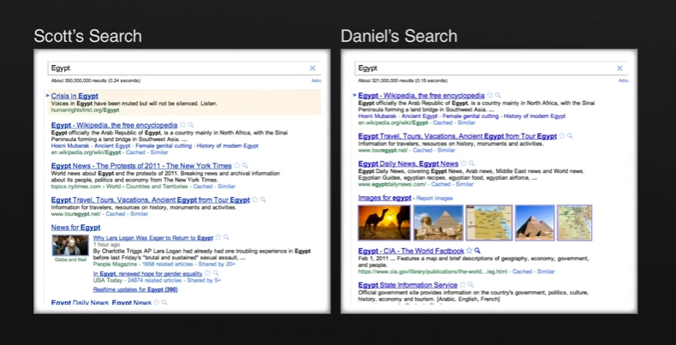
Important to understand how software can divides us
See also “Facebook emotion study breached ethical guidelines, researchers say” June 30, 2014, The Guardian http://goo.gl/gTRkmp

Slide 24
Software tools for “citizen scientists”.
Beyond mere data repositories
Software decides how we decide everything
When decision software goes wrong
Proposed services for nextgen repositories
The Future?
ai4se.net

Slide 25
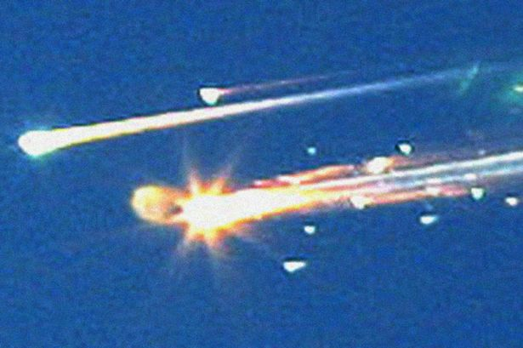
Models have “certification envelopes”
Bad things happen when you stretch the envelope
Columbia ice strike
Size: 1200 m²
Speed: 477 mpg (relative to vehicle)
Certified as “safe” by the CRATER micro-meteorite model.
A experiment in CRATER’s DB:
Size: 3cm³
Speed: under 100 mpg
Columbia, and crew, dies on re-entry
Lesson: conclusions should come with a “certification envelope”
If new tests outside of the envelope of the training set
Raise an alert

Slide 26
Lessons learned
What matters?
Certification envelopes (when not to trust conclusions)
Locality matters (when their conclusions do not hold for you)
Need “streaming tools” (continually stream over a never ending sequence of new data)
Need repair tools (to fix broken ideas)
Verification matters (sooner or later, we all screwup)
Need to transfer data (Get by with a little help from your friends)
Need compression tools (to save space)
Need privacy tools (so you can share)

Slide 27
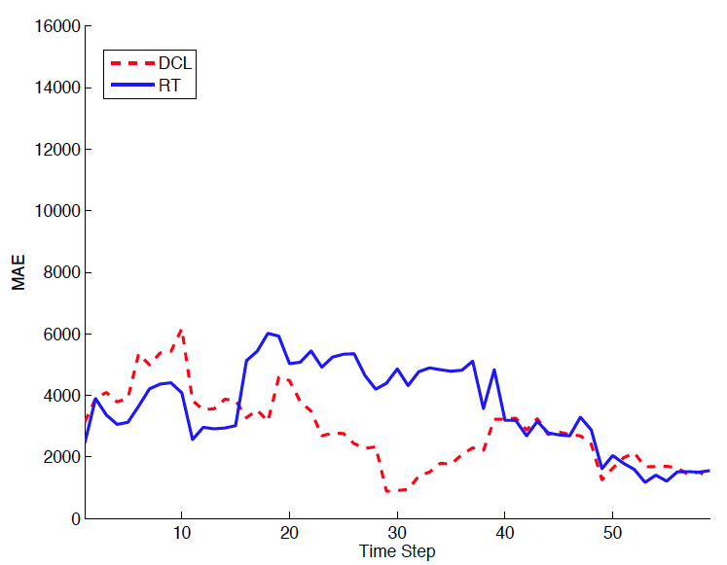
Locality matters (what is true there may not be true here)
Not general models ,but general methods for local models
Devanbu et al. ASE’11 Ecological Inference
Betternburg et al. MSR’12 Think local, act global,
Menzies et al. TSE’13 Local versus Global learning,
Yang et al. IST’13 Handling local bias,
Minku et al. ICSE’14 Best Use of Cross-Company Data
Using ensemble data
Using local data
Error (less is better)

Slide 28
Lessons learned
What matters?
Certification envelopes (when not to trust conclusions)
Locality matters (when their conclusions do not hold for you)
Need “streaming tools” (continually stream over a never ending sequence of new data)
Need repair tools (to fix broken ideas)
Verification matters (sooner or later, we all screwup)
Need to transfer data (Get by with a little help from your friends)
Need compression tools (to save space)
Need privacy tools (so you can share)

Slide 29

Sharing matters
Given enough eyes, all bugs are shallow
When (2013) | What
Mar 15 | “Better cross-company learning” accepted to MSR’13
Mar 29 | Camera-ready submitted
?Apr 10 | Pre-prints go on-line
Apr 29 | Hyeongmin Jeon, graduate student at Pusan Natl. Univ.emailed us: can’t reproduce result
May 4 | Fayola Peters, checking code, found error. Manic week of experiments follow
May 11 | We conclude results definitely wrong
May 12 | Email MSR organizers. Our penalty? Present paper and its error.
How was the error found so fast?
Open science

Slide 30
Lessons learned
What matters?
Certification envelopes (when not to trust conclusions)
Locality matters (when their conclusions do not hold for you)
Need “streaming tools” (continually stream over a never ending sequence of new data)
Need repair tools (to fix broken ideas)
Verification matters (sooner or later, we all screw up)
Need to transfer data (Get by with a little help from your friends)
Need compression tools (to save space)
Need privacy tools (so you can share)

Slide 31
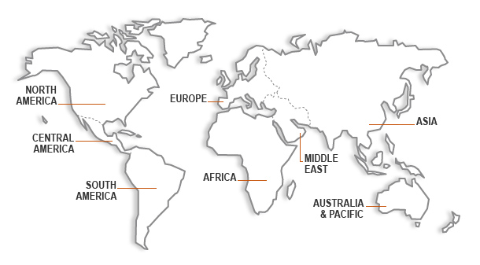

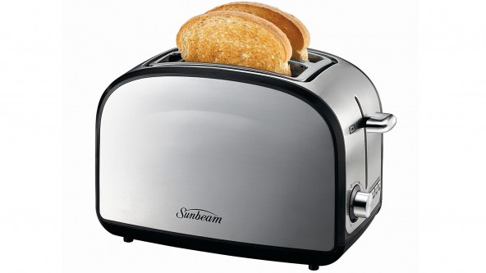
Transfer matters (and is possible)
When not enough local data, ask your friends
B.Turhan, T.Menzies, A. Bener, J. Di Stefano. 2009. On the relative value of cross-company and within-company data for defect prediction. Empirical Softw. Eng. 14(5) 2009,

Slide 32
Lessons learned
What matters?
Certification envelopes (when not to trust conclusions)
Locality matters (when their conclusions do not hold for you)
Need “streaming tools” (continually stream over a never ending sequence of new data)
Need repair tools (to fix broken ideas)
Verification matters (sooner or later, we all screw up)
Need to transfer data (Get by with a little help from your friends)
Need compression tools (to save space)
Need privacy tools (so you can share)

Slide 33
Compression and privacy matter
Squeezing and secrets
Facebook, Google, Netflix etc
Small X% of all users are subjects in continual experiments: testing new features
Data from studies, retained indefinitely, warehoused
Problems with volume (needs compression)
Problems with confidentiality (needs privacy)
If I want to challenge the conclusions made by Facebook, Google, Netflix, etc
I need to be able to access, privately, that data
(needs trusted sharing)

Slide 34
Lessons learned
What matters?
Certification envelopes (when not to trust conclusions)
Locality matters (when their conclusions do not hold for you)
Need “streaming tools” (continually stream over a never ending sequence of new data)
Need repair tools (to fix broken ideas)
Verification matters (sooner or later, we all screw up)
Need to transfer data (Get by with a little help from your friends)
Need compression tools (to save space)
Need privacy tools (so you can share)

Slide 35
Lessons learned
What matters?
Certification envelopes (when not to trust conclusions)
Locality matters (when their conclusions do not hold for you)
Need “streaming tools” (continually stream over a never ending sequence of new data)
Need repair tools (to fix broken ideas)
Verification matters (sooner or later, we all screw up)
Need to transfer data (Get by with a little help from your friends)
Need compression tools (to save space)
Need privacy tools (so you can share)

Slide 36
Software tools for “citizen scientists”.
Beyond mere data repositories
Software decides how we decide everything
When decision software goes wrong
Proposed services for nextgen repositories
The Future?
ai4se.net

Slide 37
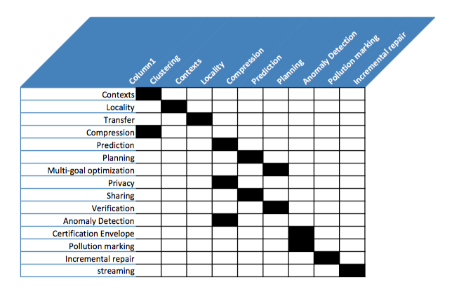
A hierarchy of services
Each cell link here is one masters-by-research or Ph.D. thesis

Slide 38

A hierarchy of services
Row X uses col Y
Each cell link here is one masters-by-research or Ph.D. thesis

Slide 39
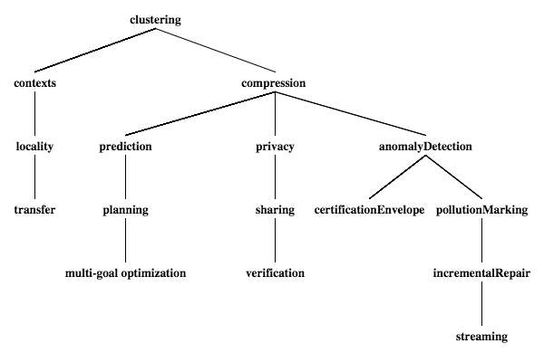
A hierarchy of services
ai4se.net

Slide 40
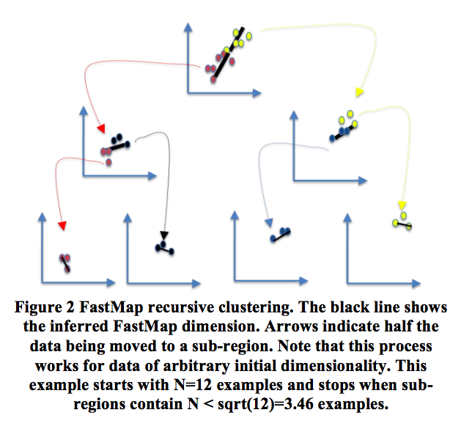
Based on WHERE: O(N) top-down divisive clustering
Fast: works on an approximation to eigenvectors (the FASTMAP heuristic) Faloutsos [1995]. A O(N) generation of axis of large variability
Pick any point X;
Find E= East = furthest from X,
Find W = West furthest from East.
East, West = “the poles”
All points have distance a,b to (E,W)
c = dist(E,E)
x = (a² + c² − b²)/2c
Find median(x), recurse on each half

Slide 41
A hierarchy of services
Executing
Published
To do
ai4se.net

Slide 42
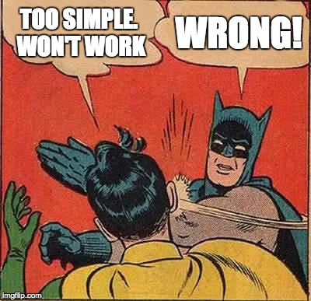

Slide 43
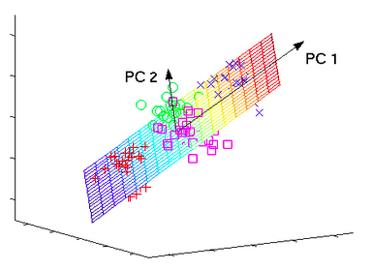
WHERE = fast analog for PCA (so WHERE is a heuristic spectral learner)
Spectral learners : works on eigenvectors
combine related influences
ignore outliers and irrelevancies
ai4se.net
43

Slide 44
Locality and transfer
Locality
Transfer
Locality:
Butcher (WVU), Menzies et al.
TSE’13, Local versus global.
Models from all data have worse medians and larger variances than models from WHERE’s clusters
Transfer:
Kocaguneli (WVU), Menzies et al.
ESEJournal 2014, Transfer learning
Hierarchical clustering,
Each test instance uses cluster tree to selects its own training (ignore “weak” clusters- those with high variance)
Works for cross-company and cross-time transfer

Slide 45
A hierarchy of services
Executing
Published
To do
ai4se.net

Slide 46
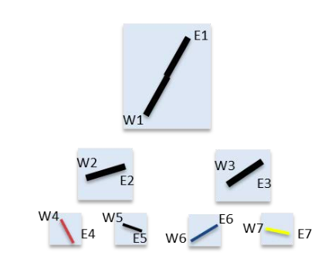
clustering ➔ compression
(poles = approximate shape of data)
If
If cluster to leaves of size sqrt(n),
Only need 2*sqrt(n)-1 nodes, each with 2 poles
So 4*sqrt(n) – 2 examples
Which we can reduce, later (see optimization)

Slide 47
By the way, remember the RHS tree: we’ll be using it a lot
If

Slide 48
compression ➔ prediction
Call each leaf one “class”
Run a decision tree learner to find a model for the “classes”
Vasil Papakroni, WVU masters thesis, 2012
Prediction using WHERE’s clusters works
Just as well as other standard methods
(for software effort and defect estimation)

Slide 49
prediction ➔ planning
Call each leaf one “class”
Run a decision tree learner to find a model for the “classes”
If the prediction is “bad”, find a nearby leaf with “better” predictions
Branch1= decision branch to “bad”
Branch2 = decision branch to “better”
Plan = Branch2 – Branch1
Rahul Krishna (Ph.D. scholar, NC state) and me, submission to ICSE’16. Planning over WHERE
clusters very effective

Slide 50
compression ➔ optimization
Evolutionary optimizers = select, crossover, mutate, repeat
Select:
Evaluate each pole as you descend the tree
Cull the half leading to the worst pole
Crossover, mutate
In the surviving leaves,
mutate examples towards to the best pole
Krall (WVU), Menzies et al. TSE 2015, GALE. Orders of magnitude faster than standard optimizers. Just as effective

Slide 51
A hierarchy of services
Executing
Published
To do
ai4se.net

Slide 52
compression ➔ privacy
Hide the individuals, preserves the shape of the data
Don’t share all the data, just the poles.
100% privacy on data not in poles
Don’t share the poles exactly,
Mutate them slightly, along, away from axis
Peters, Menzies, TSE’13, Balancing privacy and utility

Slide 53
Privacy ➔ sharing
Pass the parcel between N data owners in random order
If local data anomalous (see later)
Add to parcel
Then privatized (see last slide)
Shared, privatized data yielded better models than using all raw data
Peters, Menzies, ICSE’14, LACE2

Slide 54
Sharing ➔ verification?
With enough eyeballs,
Are all bugs are shallow?

Slide 55
A hierarchy of services
Executing
Published
To do
ai4se.net

Slide 56
compression ➔ anomaly detection
WHERE’s trees are a O(log(N)) time index to the leaves
Test data is “alien” if, after falling to its nearest leaf, it is outside of the poles
Peters, Menzies, ICSE’14, LACE2

Slide 57
anomaly detection ➔ certification envelope
If new test case anomalous
Then flash some warning (test data out of scope of training data! conclusions may be wrong! )

Slide 58
anomaly detection ➔ pollution marking
Mark in as polluted all sub-trees with more than X% anomalies
When making conclusions, stay away from the polluted sub-trees

Slide 59
pollution marking ➔ incremental repair
In all sub-trees, keep a sample of data plus any anomalies
When too many pollution markers, recluster just that sub-tree
Dianne Gordon-Spears (2002): such hierarchical incremental repair 10,000 times faster than global reorganizations

Slide 60
incremental repair ➔ streaming
Incremental repair a.k.a. stream mining

Slide 61
A hierarchy of services
Executing
Published
To do
ai4se.net

Slide 62
Software tools for “citizen scientists”.
Beyond mere data repositories
Software decides how we decide everything
When decision software goes wrong
Proposed services for nextgen repositories
The Future?
ai4se.net

Slide 63
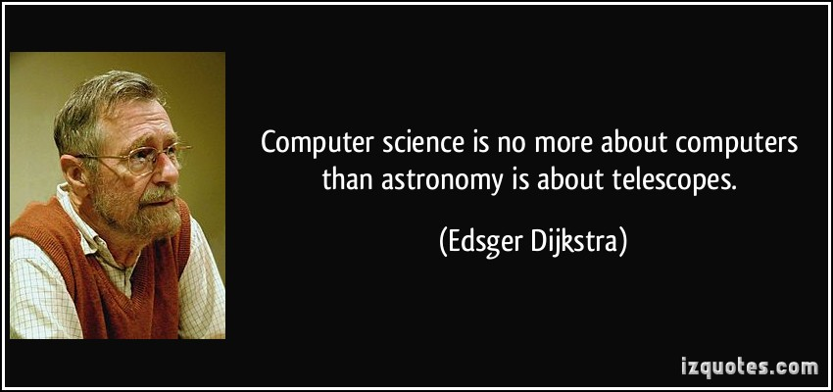
Software engineering researchers just studying software is like astronomers just studying telescopes.
After we grind the lenses, we should look through the scope.
After we build the software, we see how people are using it

Slide 64
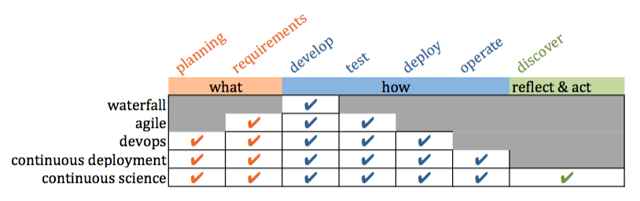
Confucius: “Study the past if you would define the future.”
History of SE
X is not part of SE
People are having trouble with X
Experiments: Extend SE to include X
Conclusion: “you know what? SE tool support makes X easier”

Slide 65
Confucius: “Study the past if you would define the future.”
Future of SE
Software mediates what we see and how we act in the world
Everyone with software is now a scientist
Software supports communities as they judge conclusions

Slide 66
To find the future, extrapolate the past
Future of SE
Software mediates how everyone sees and acts on the world
Everyone with software is now a scientist
Software supports communities as they judge conclusions

Slide 67
This talk
Services for data repositories supporting citizen scientists
Enabling reflect, act, discover
The next generation of continuous science.

Slide 68

End of my tale tail
Questions? Comments?

Slide 69
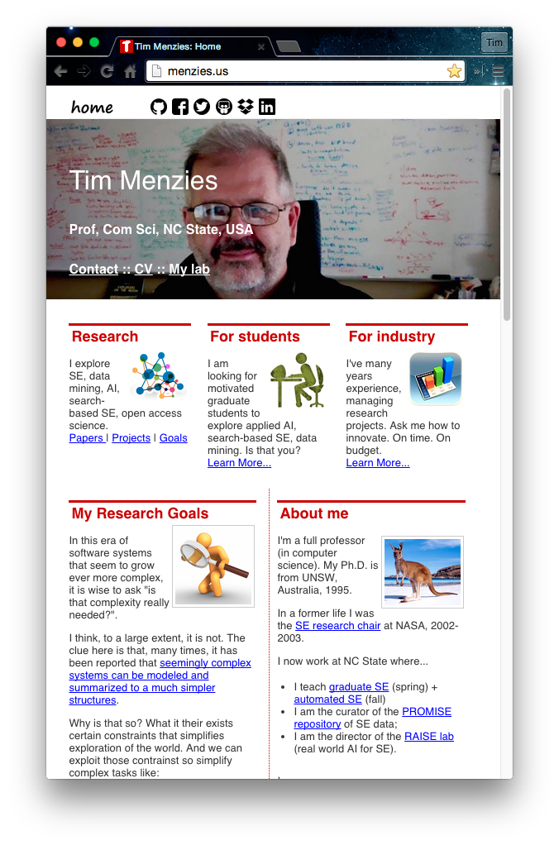
About me
Full Prof in CS NC State. Teaches SE and automated SE.
Researches synergies human+AI, with focus on data mining for SE.
Assoc editor IEEE Transactions on SE, Empirical SE, the Automated SE Journal , Software Quality Journal
Was co-PC-chair for ASE’12, ICSE'15 NIER track.
Will be co-general chair of ICMSE'16.
Author of 230+ referred pubs.
One of the 100th most cited authors in SE (of 80,000 http://goo.gl/BnFJs).
PI for NSF, NIJ, DoD, NASA, USDA, and research work with private companies.
Co-founder of the PROMISE conference series on reproducible experiments in SE.
Current curator PROMISE web site, SE research data http://openscience.us/repo .
Vita: http://goo.gl/8eNhYM
Pubs: https://goo.gl/qNQAIq
Home page: http://menzies.us

Slide 70
http://mshang.ca/syntree/
[clustering [contexts [locality [transfer]]]
[compression
[prediction [planning multi-goal optimization] ]
[privacy [sharing [verification]]]
[anomalyDetection certificationEnvelope
[pollutionMarking [incrementalRepair [streaming]]

Slide 71
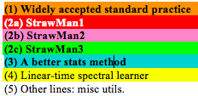
Code used in my last paper (1100 LOC of Python calling scikitlearn)

Slide 72
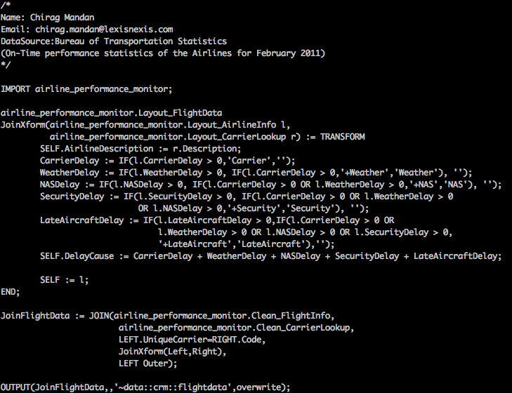
Note: not necessarily solved by higher-level languages
ECL: a higher-level set-based language (more succinct)
But if you can write it quick,
you can write it wrong, quick.
Implications for
markets, ambulances, government policies, homeland security, toasters. Air safety, Nobel prizes, web-company advertising polices, do we take the family to Cairo for a holiday, etc etc

